Slide 1






MINI PROJECT – II PRESENTATION

Slide 2
PIZZ360 WEBSITE
Supervised By: -
Mr. Anand Parkash Gupta
Mrs. Ruchi Gupta
Asst. Professor
Department of Computer Engineering & Applications
GLA UNIVERSITY MATHURA
Submitted By:
Divyansh Garg
181500222
Kunal Singh
181500341

Slide 3
INTRODUCTION
Pizz360 (Web-based Application) is a perfect mate for our Pizza Lovers, that stimulates the foodies (customers) to get their Pizzas Delivered at home in just one click. This will be a user- friendly application with proper menu tabs defined on homepage. It will have both Veg and Non-Veg Pizza’s so that people can filter out based on their taste.
For this Application we will be using both Frontend and Backend Technologies and Database for storing the data.
Our major objective will be to make this Application as much user friendly as we can and satisfying the hunger of our customers in just few clicks.

Slide 4
MOTIVATION
With the improvement of technology, online food ordering systems are becoming a popular topic. That's because they are serving the ever increasing demand for convince.
We all know that the online pizza ordering website is growing and there are lots of software available to provide these pizza ordering services but not that type of software which can provide at low price and best quality pizza directly to our consumers.
With a website or mobile app, customers can easily browse all the types of pizzas the website has available, choose pizzas to their requirements and choice and place an order.

Slide 5
OBJECTIVE
This website offers our customers a superior product i.e., that will promote customer loyalty, at a low price, and provide customer service that is second to none. Its objective is to satisfy the customer’s demand quality pizza that is delivered quickly with a smile.
Our goal is to deliver a website with a very clean user interface (website) where customers can select various kinds of pizza and place their order.

Slide 6
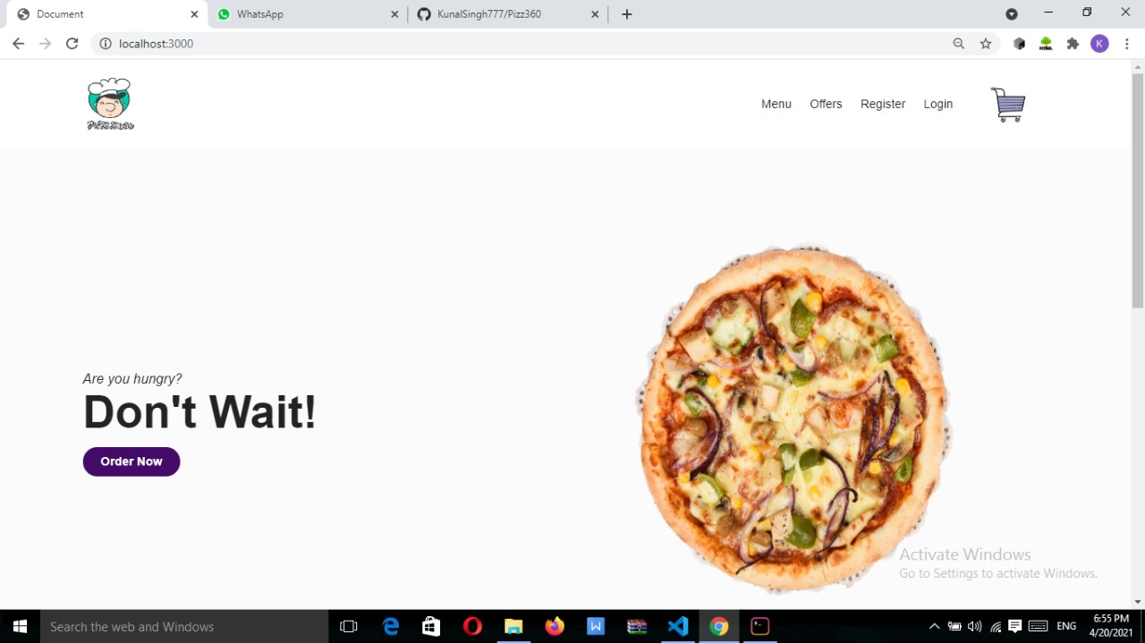
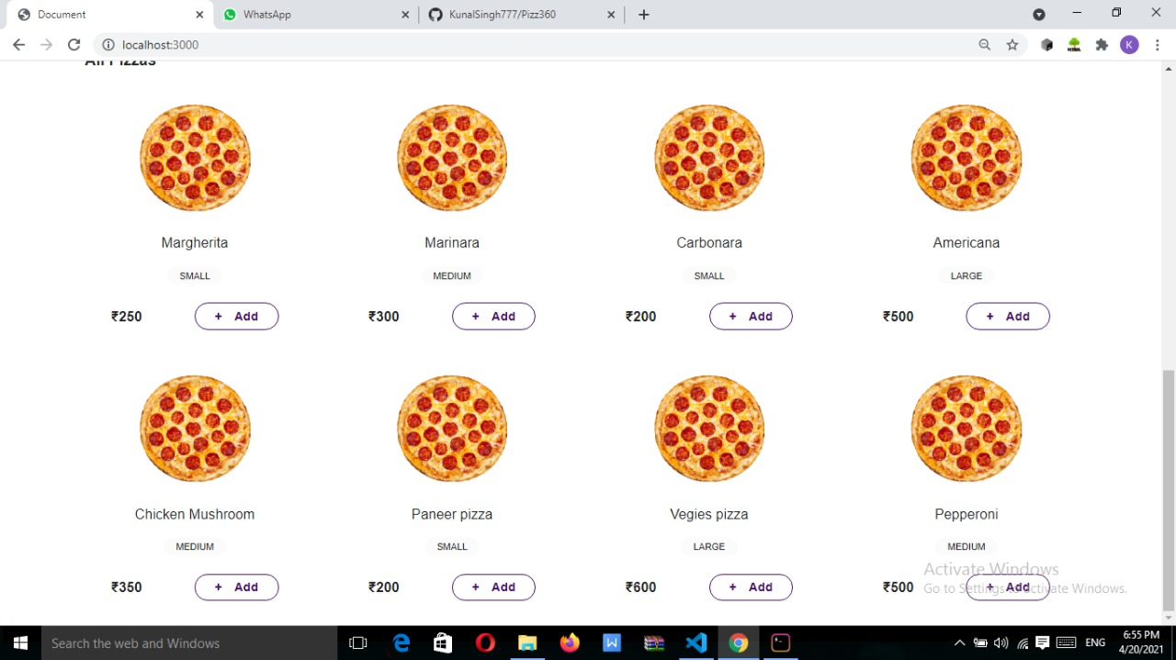
USER INTERFACE

Slide 7

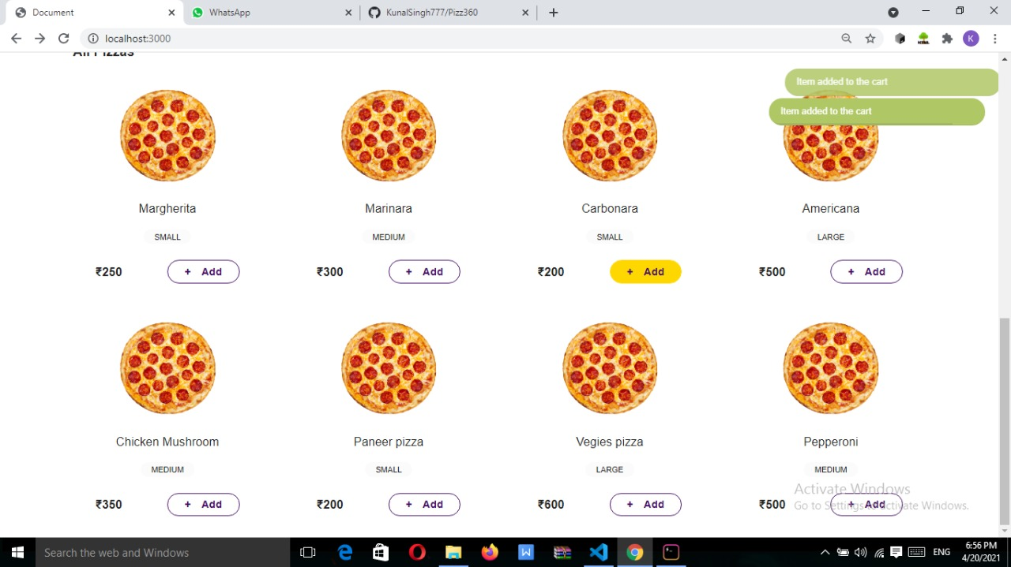

Slide 8
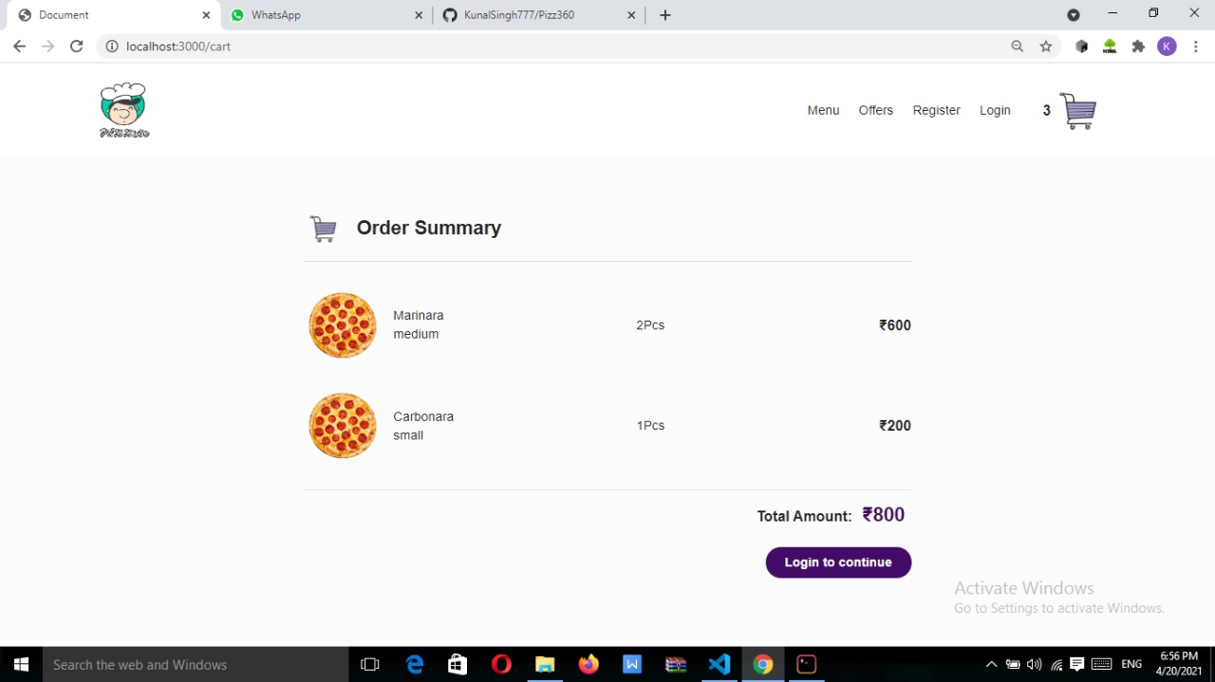
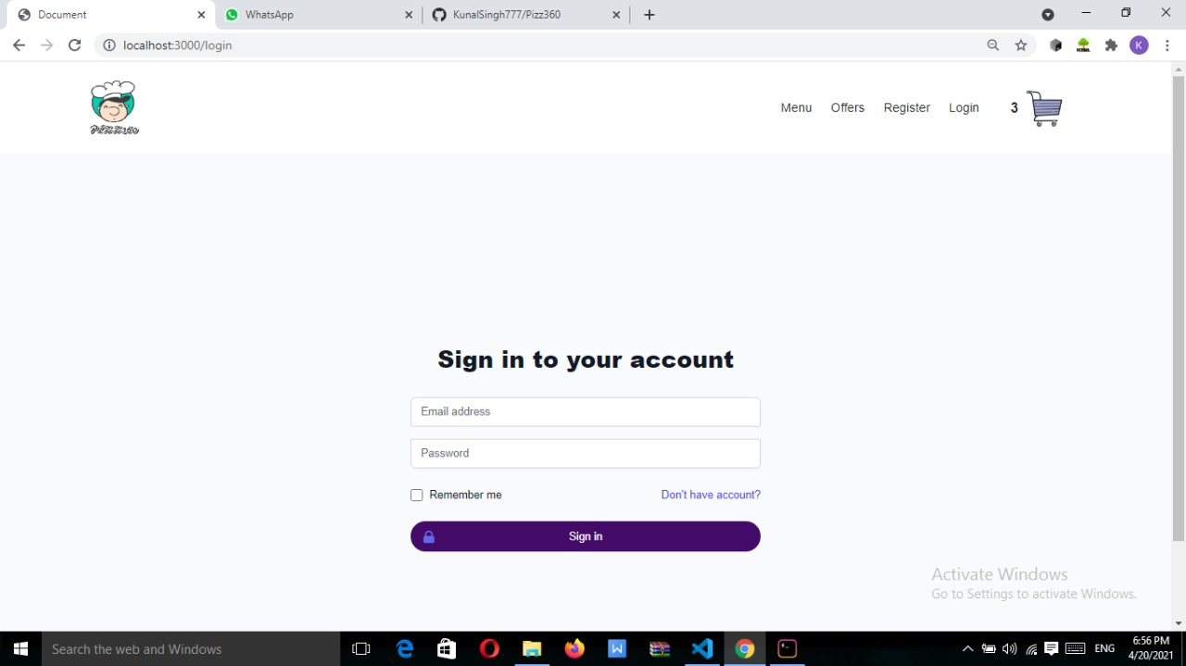

Slide 9
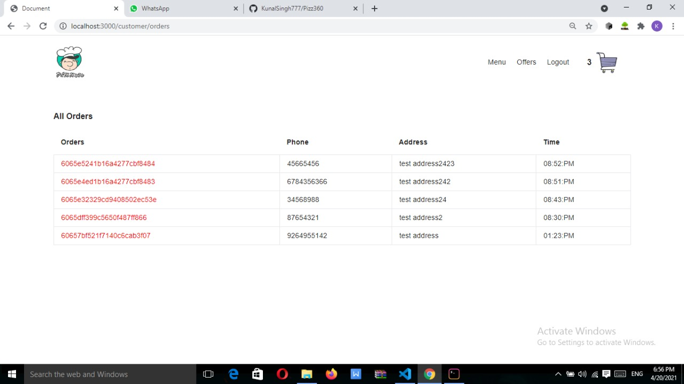
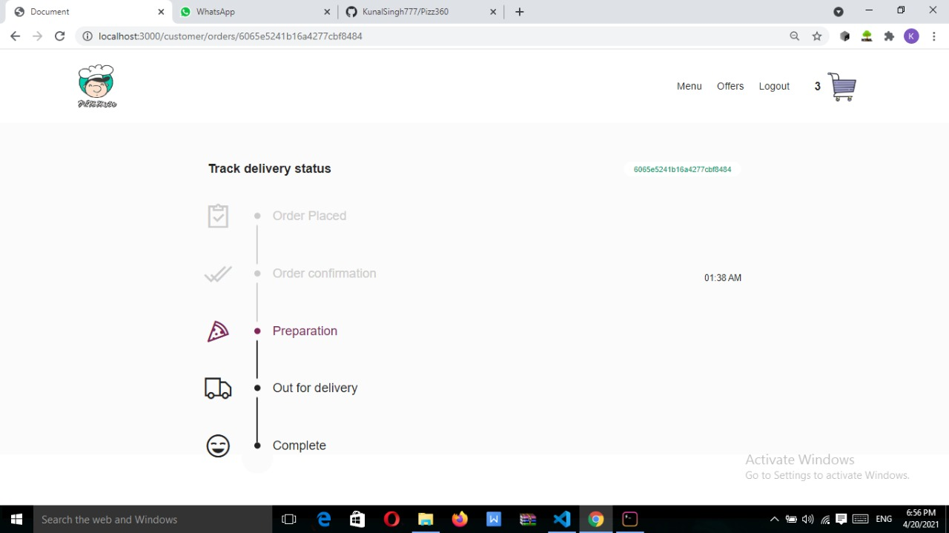

Slide 10
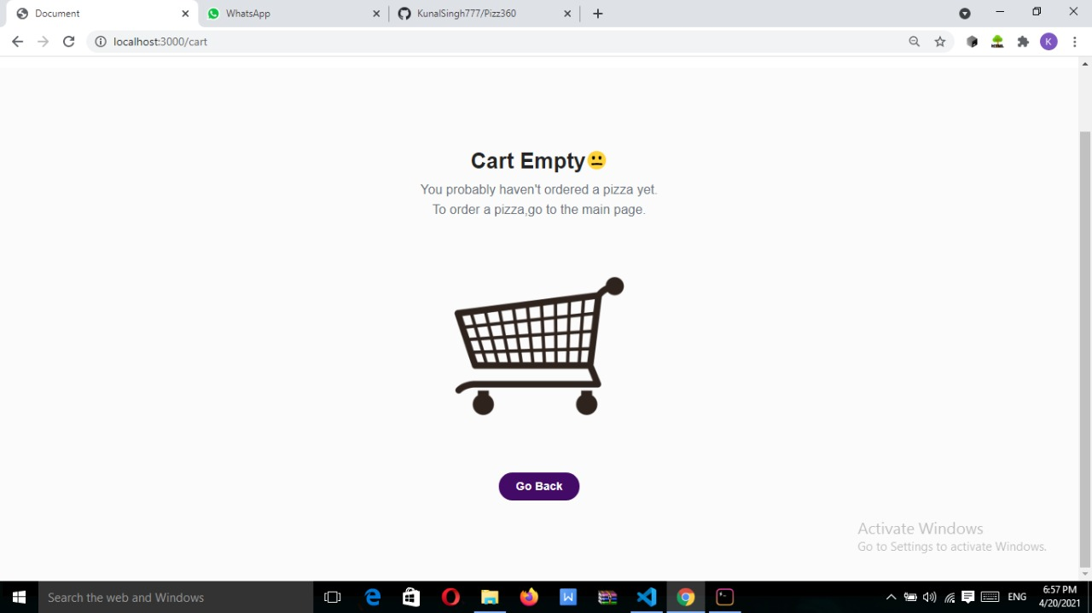
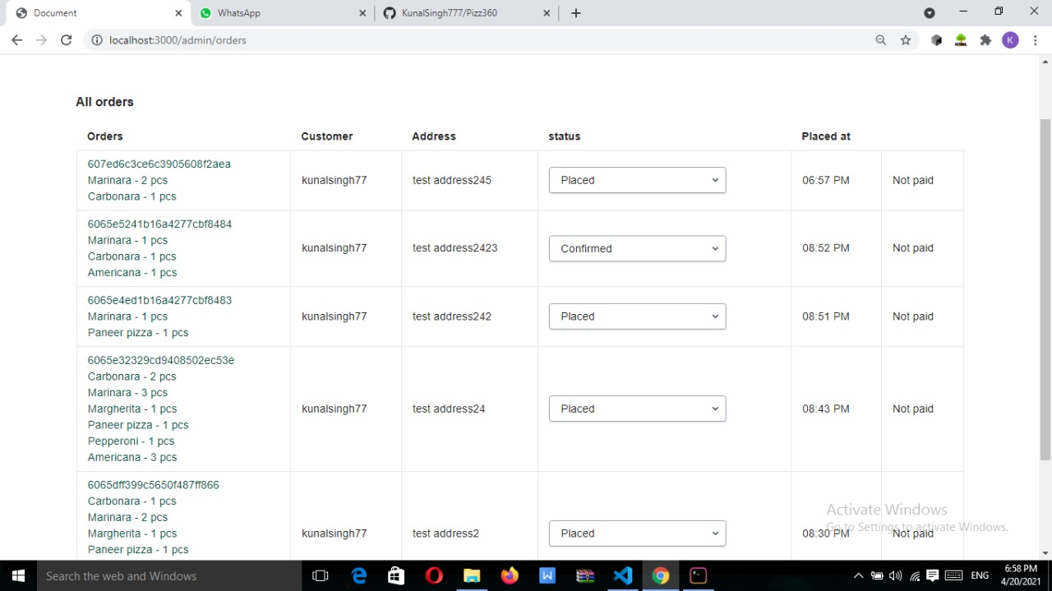

Slide 11
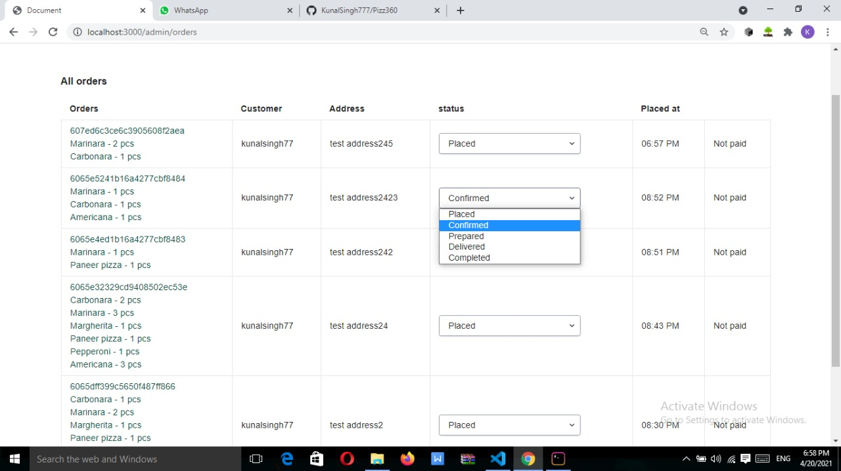
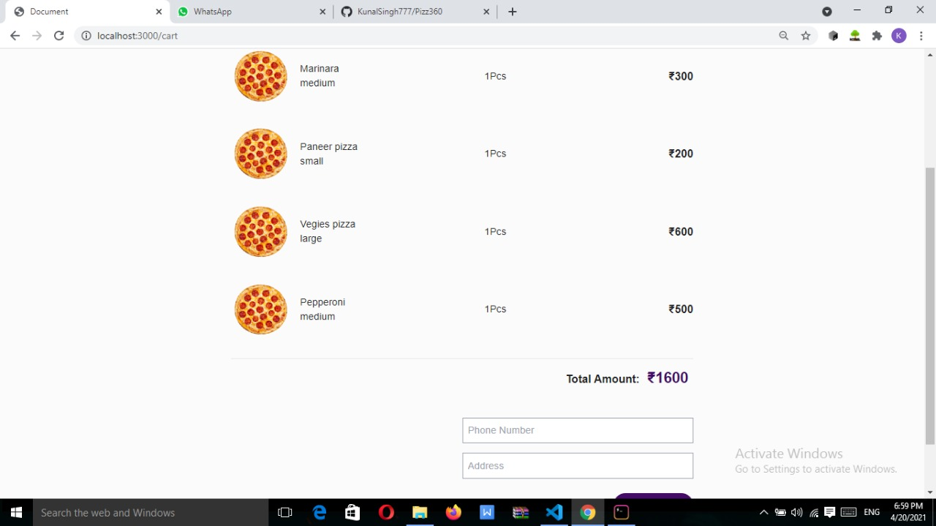

Slide 12
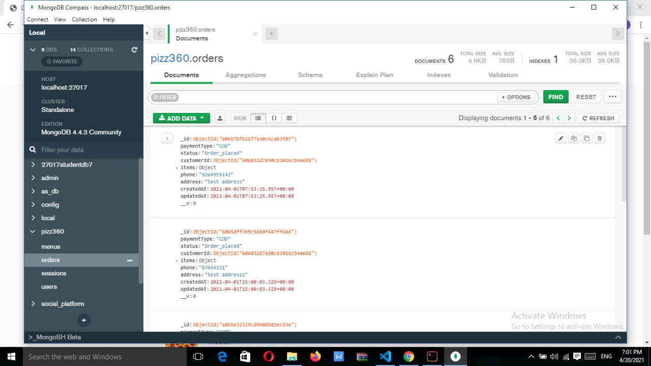
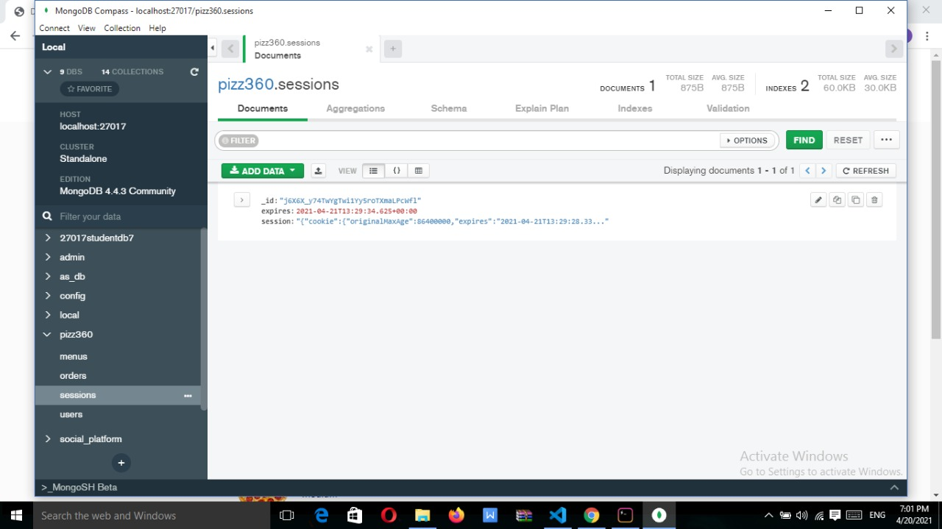
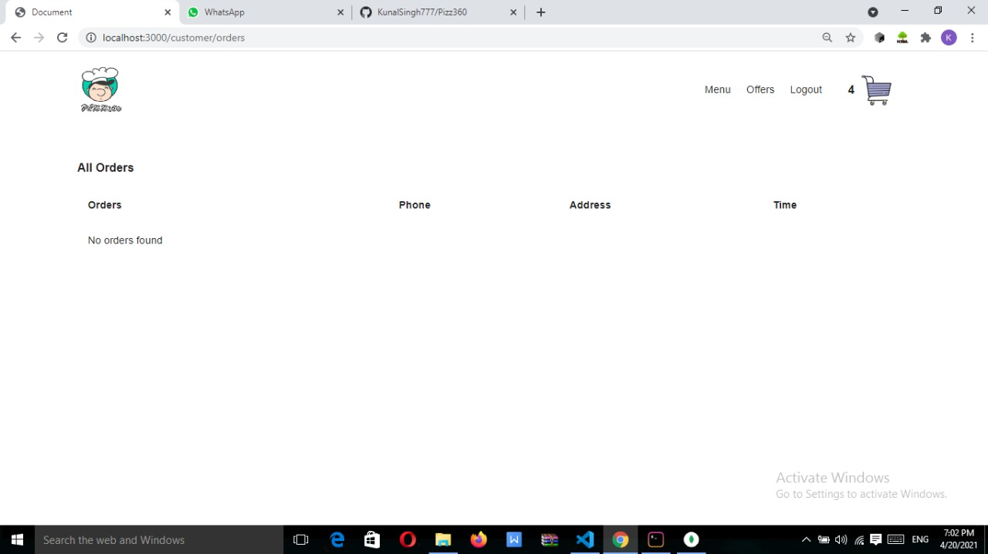
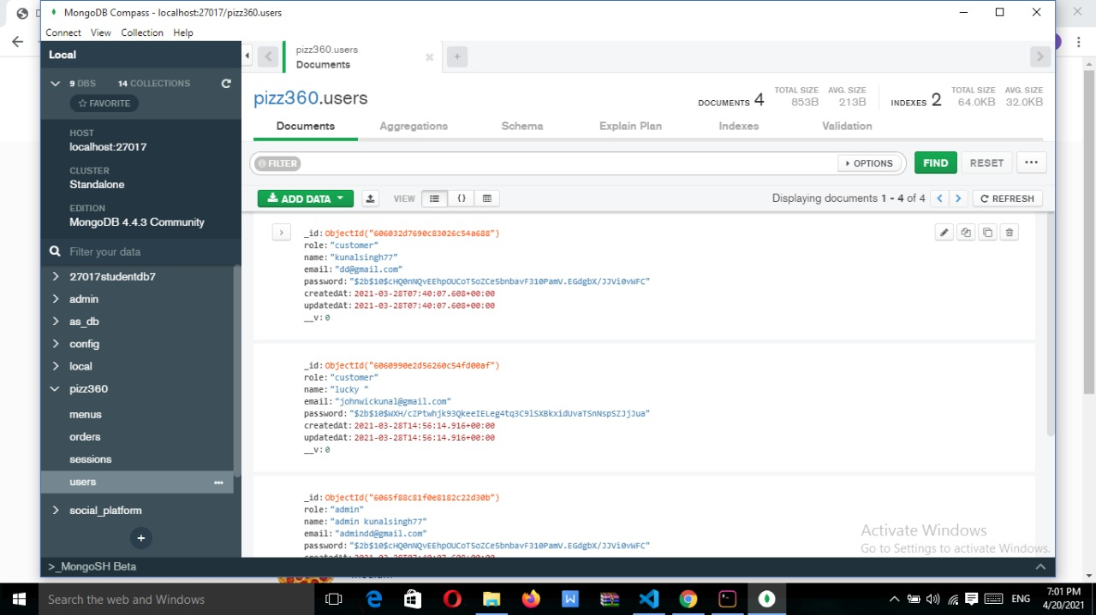

Slide 13
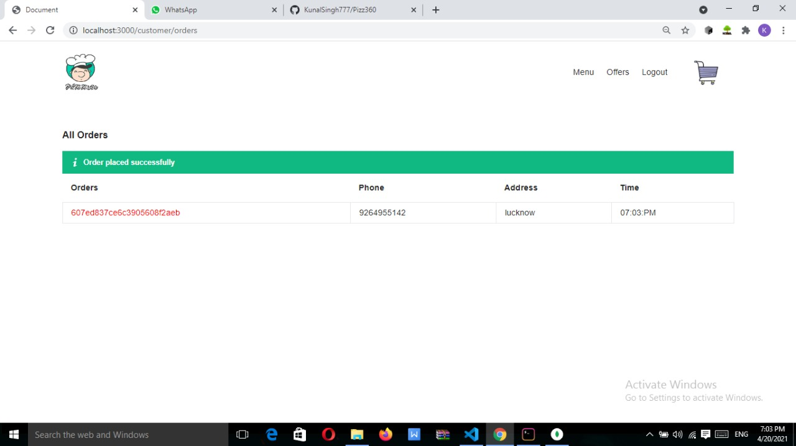
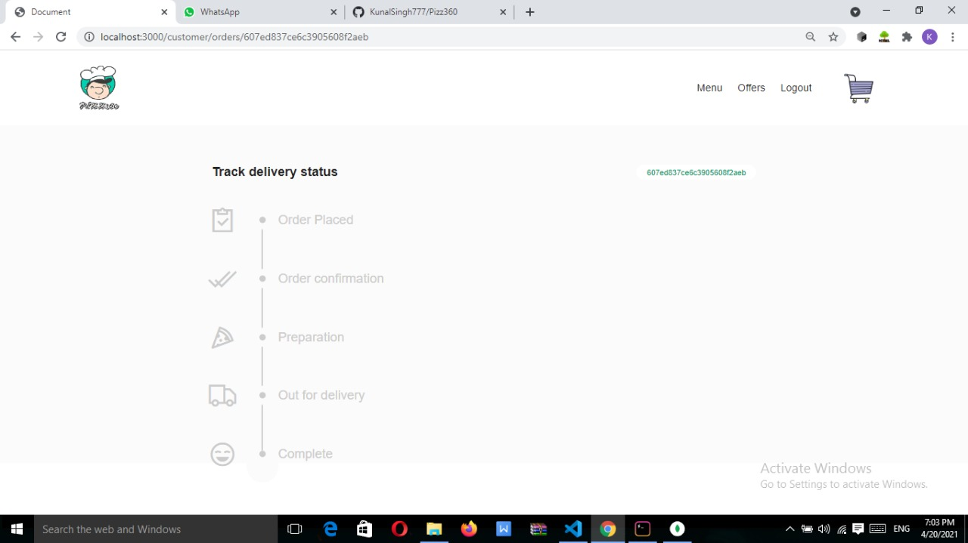

Slide 14

Project Link
GitHub Repository link:
https://github.com/KunalSingh777/Pizz360

Slide 15
CONCLUSION
We have made a online pizza ordering website, named PIZZ360 which is in partial fulfillment state we have done extensive hard work in the front end section and also created a login signup page whose information is stored in a database on the server, we have use various web development technologies till now ,like HTML5 ,CSS3, Bootstrap , JavaScript , Mongo DB, NodeJS and various tools like Visual studio code , google chrome, this is all possible because of the guidance of our mentors , further we will add backend to make it fully functional .
As someone with no prior experience in web development, we believe our time spent in training and discovering new languages was well worth it and contributed to finding an acceptable solution to an important aspect of web design and development.

Slide 16
FUTURE SCOPE
In the coming future we aim to make our website more applicable and well appearing ,we will add payment mode to this website so that customers can order their pizza in just few clicks and every information will be saved at the backend.

Slide 17
THANK YOU

